Slide 1
A GUIDE TO TEACHING ALLOY 6
Notes:
Hi, I am (name and surname) from Polytechnic of Milan and I am here to present a guide to teaching Alloy 6 via a didactic module created by me and my colleagues (names and surnames)..

Slide 2
INTRODUCTION
WHY A TEACHING MODULE ON ALLOY 6?
A teaching module is a significant, highly homogeneous and unified part of a planned disciplinary program, having well-defined verifiable objectives based on building up skills and knowledge in discrete units.
Methodology
Ability
Usability
To create an engaging method that makes students more accountable and calls them in for self-assessment on their understanding of new concepts and for solving exercises and real problems.
To make SE students being able to develop good software that can be delivered within specific requirements using a formal specification language like Alloy.
Alloy 6 is useful, especially with the new temporal logic introduced in the sixth version.
Notes:
…First of all: why a teaching module on Alloy 6? A teaching module is a significant, highly homogeneous, and unified part of a planned disciplinary program, having well-defined verifiable objectives based on building up skills and knowledge in discrete units. This kind of teaching approach can be useful to create an engaging method that makes students more accountable and calls them in for self-assessment on their understanding of new concepts and for solving exercises and real problems. In particular, one of the main goals of SE is to make software that must be delivered within specific requirements and therefore a teaching method that helps SE students to learn a specification language like Alloy is important. In particular, Alloy 6 has become even more useful with the release of the sixth version that introduces a new temporal logic...

Slide 3
INTRODUCTION
THE PROBLEM
The fundamental aspect of the definition of a teaching module is the identification of learning objectives so that students understand what is required of them. In order to get students more deeply involved in the learning process, it is necessary to adopt a strategy that allows a "balance of power" between students and teachers, making lessons interactive and dynamic. A successful lesson requires the introduction of alternative teaching strategies that allow students to test themselves and assess their own level of understanding during the lesson.
Notes:
…One of the fundamental aspects. In order to get students more deeply involved in the learning process, it is necessary to adopt a strategy that allows a "balance of power" between students and teachers, making lessons interactive and dynamic, and thus more student-centered. A successful lesson requires the introduction of alternative teaching strategies that allow students to test themselves and assess their own level of understanding during the lesson…

Slide 4
THE SOLUTION
SCHEDULE
First Theoretical Lecture: Alloy 5 vs. Alloy 6 / Alloy 6 intro, LTL, var keyword
Flipped Classroom: Alloy 6 temporal operators
Second Theoretical Lecture: Quiz / Alloy 6 new visualizer, time horizon
Exercise Lecture: 3 summary exercises on Alloy 6
Home Exercise
Challenge
45min
15min
45min
90min
25min
2weeks
Several didactic forms were used to define an effective Alloy 6 teaching module, all listed here on the left with the suggested schedule.
→ Lessons
→ Exercises
→ Challenge
Notes:
…In this module, several didactic forms were used and they are all listed here on the left with the suggested schedule. Overall, the teaching module consists of lessons, exercises, and a challenge…

Slide 5
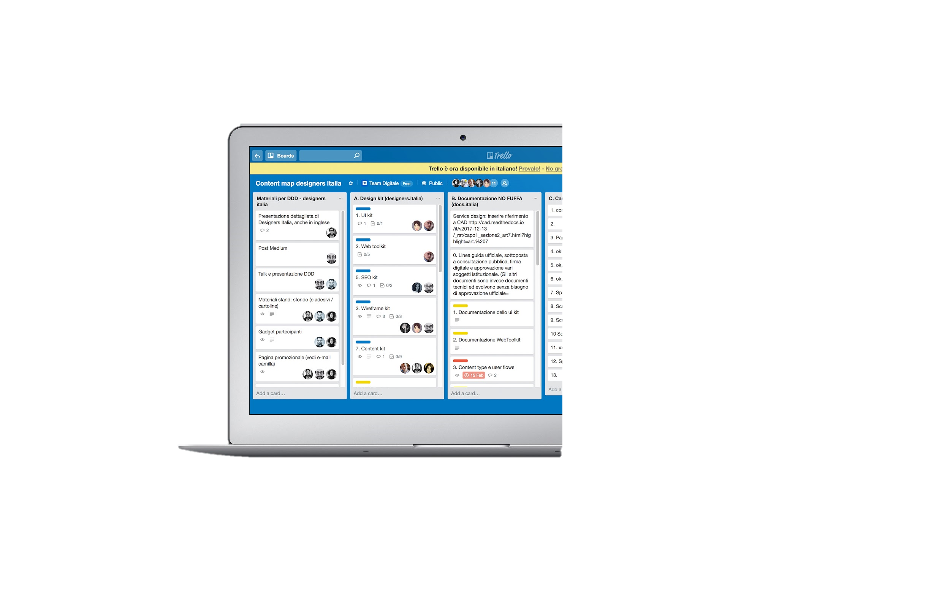

LESSONS
45
First Theoretical Lecture
MIN
PRE-REQUISITES
First-order logic and Alloy 5
STRATEGIES
Structuring lesson, Setting goals, Traffic-light questioning, feedback
TOPICS
- Overview of learning objectives (5 min.)
- Static vs. Dynamic world (5 min.)
- How to represent dynamic models in Alloy 5 (20 min.)
- Alloy 6 (10 min.)
LEARNING OUTCOMES
- How Alloy 5 deals with dynamic modelling - Limitations of dynamic modelling in Alloy 5 and the need of a new version
MATERIALS
Powerpoint slides
Notes:
…the first lecture lasts approximately 45 minutes. The prerequisites are the knowledge of first-order logic and of Alloy 5. The main strategy to follow is structuring lesson with the aid of succinct PowerPoint slides used as the main material to call attention, especially to the main concepts. At the beginning of the lecture, the setting goals strategy is chosen to explain exactly what students are supposed to understand and what they must be able to do. The first part of the lesson must link to the previous students’ knowledge of Alloy 5. In order to indicate the students’ level of content understanding, traffic light questioning and feedback from students must be present during the lesson.
The aim of the first lesson is to make a comparison of how variant time systems are represented in Alloy 5 and Alloy 6, showing how the latest version of the language is more effective for this purpose due to the introduction of a new logic and new keywords. A detailed list of the topics covered in the first lesson is given here. At the end of this first lesson, students should be able
to understand
-How Alloy 5 deals with dynamic modeling
-The limitations of dynamic modeling in Alloy 5 and the need for the new version of Alloy…

Slide 6

LESSONS
15
Flipped Lecture
MIN
PRE-REQUISITES
First Lecture
STRATEGIES
Explicit-teaching, questioning and feedback.
TOPICS
- Alloy 6 temporal operators (past and future) (15 min.)
LEARNING OUTCOMES
- Usage of Alloy 6 temporal connectives with awareness - Ability to deal with Alloy 6 new keywords
MATERIALS
Powerpoint slides and Video
Notes:
… After the first lecture, there is a flipped lecture consisting of a 15-minute video where temporal connectors introduced in Alloy 6 are explained with the aid of some PowerPoint slides. The strategy used by the teacher here is explicit teaching. The teacher, in the recorded video, unidirectionally explains the concepts leaving the opportunity to raise doubts and gather opinions in the next lesson. Students’ Feedback and questioning are handled in the second theoretical lesson. As previously mentioned, The focus of the flipped-classroom is on temporal
connectives, both present and future, which the user can use after understanding the concept of LTL to define assertions, facts, and predicates. All connectives are presented in the same way, always following the same pattern: syntactic definition, semantics, and application example. At the end of the flipped-classroom, students are ready to use with awareness all temporal connectives provided by Alloy 6 and they are able to face the following arguments such as time horizon, new visualizer, and concurrency. With this method, students develop the ability to study independently with a video, without a guide

Slide 7

LESSONS
45
Second Theoretical Lecture
MIN
PRE-REQUISITES
First lecture and Flipped lecture
STRATEGIES
Structuring lesson, peer and teacher feedback (quizzes),
traffic-light questioning
TOPICS
- Quizzes about the previous and flipped lecture content (20 min.)
- Alloy 6 time horizon, new visualizer and concurrency (25 min.)
LEARNING OUTCOMES
Self evaluation of Alloy 6 through quizzes
Knowledge of Alloy 6 concepts and possibilities
MATERIALS
Powerpoint slides
Notes:
…The second lesson has two main objectives: the first is to check, as mentioned above, the student's understanding relative to the first lesson and the flipped classroom; the second is to carry on the explanation of the new features introduced by Alloy 6.
The main strategy to follow is again structuring lessons with the aid of succinct slides. The first part of the lesson must link to the previous students’ learning furnishing opportunities for self-assessment, peer feedback, and teacher feedback through quizzes. In the second part of the lesson traffic light questioning is again useful during the teacher’s explanation.
At the end of the lecture, students will be able to evaluate themselves and comprehend whether their study method for Alloy 6 was effective or not, based on the results of quizzes taken during class time. Finally, they will have a comprehensive overview of the innovations and expressive power of Alloy 6…

Slide 8

EXERCISE
90
Exercise Lecture
MIN
PRE-REQUISITES
All lectures (first, flipped and second) AlloyTools installed
STRATEGIES
Worked-example, feedback and questioning
TOPICS
- Ex. 1: Concurrent communication in distributed systems (15 min.)
- Ex. 2: Travel (interrail) (30 min.)
- Ex. 3: Mailbox (20 min.)
LEARNING OUTCOMES
Knowledge of Alloy 6 language and Alloy Tools
Ability to model scenarios
MATERIALS
Powerpoint slides,
.als source codes
Notes:
…After the theoretical part, the exercise lecture is an optimal time to fix the concepts seen in class. Two paradigmatic exercises allow the lecturer to exhaustively review what was explained during the theoretical lecture and to show some of their possible application through the Alloy Analyzer. The total duration of the exercise is 90 minutes. To tackle the in-class exercise and solve the home
exercise, students must
-have attended the lectures in which the features of Alloy 6 were presented
-have watched the video related to connectives, which will be extensively used when defining predicates, facts and assertions
-have successfully installed the latest version of the Alloy tool.
The strategy to be adopted by the teacher is the worked-example, along with questioning and feedback. In detail, the lecturer starts the exercise by writing the code together with the students using the exercise prompts as an opportunity to review and demonstrate how to get to the definition of facts, predicates, and assertions with a practical and easy-to-understand example. In order to have a learner-centered lecture, the lecturer leaves space and time for students by interacting with them and having them come up with possible solutions for the exercises and ask when in doubt.
The first exercise deals with concurrent communication in distributed systems, the second deals with interral, and the third one with mailbox, which can also be given as a homework assignment.
The teacher can use the set of slides created with the texts and codes from the exercises. The slides also contain animations that graphically render the meaning of the code all the way through. In addition to the slides, there are .als source codes of all the exercises, already tested, which can be run in the classroom and left to the students.
At the end of the exercise, students will be more aware of the potential of Alloy and some of its applications. They will be able to model realistic scenarios thanks to the examples seen and the strategy adopted by the teacher, and thus ready for the extra activity…

Slide 9

CHALLENGE
2
Challenge
weeks
PRE-REQUISITES
All lectures (first, flipped and second) and exercises
STRATEGIES
Collaborative-learning, team-working, problem-solving
TOPICS
- Software-Defined Network
LEARNING OUTCOMES
Ability to model a realistic and complex scenarios
MATERIALS
Powerpoint slides
Notes:
…Eventually, there is a challenge in which students can apply what they have learned in solving a particular specification within a two-week time frame. The challenge aims to model a complex scenario exploiting the approach seen in the tutorial and all the background provided by the lectures.
To tackle the challenge exercise and solve the exercise, students must:
- Have attended the lectures in which the features of Alloy 6 were presented
- have watched the video related to connectives, which will be extensively used when defining predicates, facts and assertions
- have attended the exercise
have installed the latest version of the Alloy tool
have understood the delivery method
Here, the teacher uses the strategy of collaborative-learning, having students work together in small groups (2 or 3 students) and allowing them to develop skills related to teamworking and problem-solving. Since the effectiveness of the teaching module is to be observed all the way through, the lecturer should give directions only when strictly necessary.
The proposed theme for the challenge is Software-Defined Network: a very current approach in cloud computing and network architectures that facilitates their administration and configuration in order to improve performance and facilitate their monitoring. It is required to model signatures, then static behavior, and finally dynamic behavior.
The teacher provides the slide set containing the outline of the challenge and how to deliver it.
At the end of the challenge and thus at the end of the module, students will be able to face situations in which they are required to model something very complex by working in a group in a very current, practical, and professional setting. What students are going to model is a real and current problem that does not necessarily have only one solution. Problem solving, which is the skill that the challenge greatly develops, wants each person to propose a personal solution based on what they have seen in class, which is not enough though to solve fulfill the request since an extra step is required.

Slide 10

MODULE MATERIAL
You can find all the materials by scanner this QRCode

Slide 11
ALLOY 6 A MATTER OF TIME
Authors:
Luca Padalino
Francesca Pia Panaccione
Francesco Santambrogio
Notes:
Good morning/evening, we are Francesco Santambrogio, Francesca Pia Panaccione, and Luca Padalino, and we are here to present Alloy 6 and the new features introduced into such a formal specification language. This new major version was released two years ago, in 2021, especially to incorporate the important notion of time within the language, for this reason, the subtitle we gave to this lecture is “a matter of time”. In order to figure out why Alloy 6 has been released, let’s make a step back….

Slide 12

ALLOY 6
Introduction
ALLOY 6!
ALLOY 6
https://github.com/AlloyTools/org.alloytools.alloy/releases
Notes:
…Alloy 6 comes into play here thanks to its new features…

Slide 13
ALLOY 6
Introduction
Alloy 6: there is an implicit, built-in notion of (discrete) time
Linear temporal logic
Time horizon
1
4
2
Mutable signatures and fields
New visualizer
5
6
3
Temporal operators
Cocurrency
Notes:
…As a matter of fact, unlike the previous versions, Alloy 6 has an implicit, built-in notion of discrete time and this is possible especially because Alloy 6 introduced a new logic: the linear temporal logic, on which all the new features of Alloy 6 are based…

Slide 14
ALLOY 6-Syntactic overview TEMPORAL CONNECTIVES
Authors:
Luca Padalino
Francesca Pia Panaccione
Francesco Santambrogio
Notes:
In this video, as mentioned in the first theoretical lecture, I am going to present all of the new temporal connectives introduced in Alloy 6…

Slide 15
LINEAR TEMPORAL LOGIC (LTL)
1
Definition
LINEAR TEMPORAL LOGIC (LTL): «an infinite sequence of states where each point in time has a unique successor, based on a linear-time perspective»
[1]
i-N
i-2
i-1
i
i+1
i+2
i+N
Past states
Current state
Future states
[1] Ashari, R., & Habib, S. (n.d.). LINEAR TEMPORAL LOGIC (LTL).
Notes:
…Getting back into the discussion about the new temporal logic of Alloy 6, such logic is defined by professors Ashari and Habib from the University of Colorado as an infinite sequence of states where each point in time has a unique successor, based on a linear-time perspective. Like most specification languages, Alloy divides time into a series of discrete steps, where i is denoted as the current state, i+ the future states and i- the past states…

Slide 16
INTRODUCTION
2
Signatures
sig Person {
var liveness: Liveness
}
SIGNATURES
enum Liveness {Alive, Dead}
Notes:
…Let’s introduce the signatures we are going to use in this video to show some examples of the new temporal connectives: we have a signature Person having a variable field called liveness, which is a relation with one atom of the Liveness signature, in particular, an enumeration signature that tells the two possible “states”, let me say, of a human being: alive and dead…

Slide 17
INTRODUCTION
3
Signatures
pred Die [p: Person] {
p.liveness = Alive
p.liveness' = Dead }
PREDICATES
Notes:
…Then, we have also a predicate Die that takes as input a Person and says that at the current state, the person is alive and then at the next state is dead: note that in order to refer to the value of the liveness relation in next state, we use the symbol prime: we can use also the temporal connective after as we’ll se later…

Slide 18


TEMPORAL CONNECTIVES
4
Goal
To express constraints that hold at different instants of time
or for a certain amount of time
How can we express that a person is not immortal?
How can we express that a person cannot come back to life?
Notes:
…So the goal of this video is to express constraints that hold at different instants of time or for a certain amount of time. Thus, In Alloy 6, we can easily define also constraints dealing with time, like how to express that a person is not immortal, or that a person cannot come back to life and etcetera…

Slide 19
TEMPORAL CONNECTIVES
5
Goal
To express constraints that hold at different instants of time
or for a certain amount of time
How can we express that a person is not immortal?
How can we express that a person cannot come back to life?
TEMPORAL CONNECTIVES
Notes:
…the answers to all of these questions lie in the temporal connectives!...

Slide 20
TEMPORAL CONNECTIVES
7
Eventually
fact NoResurrection {
always (all p:Person| p.liveness = Dead implies always p.liveness = Dead)}
ALWAYS
Notes:
…let’s try to add a constraint for our model through the always temporal connective: for example, we want to say that in our model the resurrection is not possible. We can say that it is always true that if a person is dead, he will be always dead. Note that the functions of the two “always” present in the fact is different: the first one is needed to say that this fact must be respected in all future states starting from the initial one. If not added, we say that this fact must be true only in the first state, while then, starting from the second state, it can be respected or not. The second always instead is important to say that if the liveness value of the person is dead at the analyzed state, then the person is dead at the future states (and at the current one as well obviously)…

Slide 21
TEMPORAL CONNECTIVES
9
Eventually
assert NoResurrection {
always (all p:Person| p.liveness = Dead implies after p.liveness = Dead)}
AFTER
Notes:
…here there is an example with after, namely an assertion to check the NoResurrection property we have previously expressed only with always. Here we again say that it is always true that for each person if he is dead at the currently analyzed step of the trace, then he is dead also in the next step. Note that since we say that this fact must be always respected since the initial state, this is equivalent to using always instead of after here. For this reason, if we check this assertion, Alloy does not find any counterexample…

Slide 22
TEMPORAL CONNECTIVES
11
Eventually
fact noImmortality {
always (all p:Person | p.liveness = Alive implies after (eventually p.liveness = Dead))}
}
EVENTUALLY
Notes:
…here there is an example of eventually: a new fact saying that immortality must not be present in our model, therefore we say that it is always true that for each person p, if that person p is alive at the current state, then at some point in the future he will die. Here we can add the connective after before eventually to remove the current state as a possible state where the predicate after “eventually” is true: basically we narrow down the possible states where p.liveness = Dead by excluding the current state…

Slide 23
TEMPORAL CONNECTIVES
13
Eventually
pred Mortality1 {
all p:Person |
always eventually p.liveness = Dead
}
ALWAYS
+
EVENTUALLY
pred Mortality2 {
all p:Person |
eventually always p.liveness = Dead
}
Notes:
…We can make an example of the two expressions by expressing the mortality of a person: first we say that for each person p it is always true that at some point in the future p will be dead. We can express the same predicate in a slight different way by inverting the two connectives: in this second case, it is said that for each person p it is true that sooner or later p will be dead and will remain such…

Slide 24
TEMPORAL CONNECTIVES
15
Historically
fact NoDeadThenAlive {
always (all p:Person | p.liveness = Alive implies historically p.liveness = Alive)}
HISTORICALLY
Notes:
…we can use historically with this fact to constrain that in our model it is always true that if a person is alive, this means that he has always been alive from the beginning of the trace: with this example we can appreciate that historically is the dual of always and therefore they constrain diametrically opposed facts…

Slide 25
TEMPORAL CONNECTIVES
17
Before and Once
fact DeadSinceDeath {
always (all p:Person | p.liveness = Dead implies once Die [p])}
ONCE
Notes:
…We can use once to express another fact for our model that says that it is always true that if a person p is dead, this means that once he died, that is, he died in at least one past state. Then, since we constrained that if a person is dead, he remains dead forever, the die predicate can be true only one single time for each person.

Slide 26
TEMPORAL CONNECTIVES
19
Before and Once
assert IfAliveBeforeAlive {
after
(always (all p:Person | p.liveness = Alive implies before p.liveness = Alive) )}
BEFORE
Notes:
…Here there is an example with before. In particular, it is an assertion to check if it is true that, starting from the second state, it is always true that if a person is alive, then before has always been alive. Note that we have to add after before the assertion since before is false in state 0 by default. Obviously this property is guaranteed by the fact with historically, therefore Alloy does not found any counterexample if we check it…

Slide 27
TEMPORAL CONNECTIVES
21
Until
fact AliveUntilDeath {
always (all p:Person | p.liveness = Alive implies (p.liveness=Alive until p.liveness = Dead))}
UNTIL
Notes:
…for instance, we can have a fact named LifeCycle, where it is said that for each person p it is always true that if p is alive, he remains alive until he is dead. Note that p.liveness = Alive is true until and excluding the state where p.liveness = dead is true …

Slide 28
TEMPORAL CONNECTIVES
23
Releases
assert AliveUntilDeath2 {
always (all p:Person | p.liveness = Alive implies (Die[p] releases p.liveness = Alive))}
RELEASES
Notes:
…In this case, we use releases to create an assertion in order to check whether it is always true that if a person is alive, then the fact that he will die at some point in the future, releases the fact that he is alive, meaning that the person dies before the fact that he is alive becomes false and this is true since the predicate Die is defined as the current liveness is alive and the next one is dead. Releases is true even if Die never occurs and p.liveness = Alive is always true, which makes sense in this example because if the person does not die, he will live forever. This second option is not possible in our model, while the first one is always true, therefore Alloy does not show any counterexample…

Slide 29
TEMPORAL CONNECTIVES
25
Triggered
assert DeadSinceDeath2 {
always (all p: Person | p.liveness = Dead implies (Die[p] triggered p.liveness = Dead))}
TRIGGERED
Notes:
…let’s make an example through an assertion. We want to check whether it is always true the fact that a person is dead implies that his death triggered the fact that he is dead: it is equal to say that he is dead since his death at least until now. Since it is equivalent to an already expressed fact, Alloy does not show any counterexample for this assertion…

Slide 30
TEMPORAL CONNECTIVES
27
Since
assert DeadSinceDeath2 {
always (all p: Person | p.liveness = Dead implies (p.liveness=Dead since Die[p]))}
SINCE
Notes:
…an example of the use of since can be this one: it is always true that for each person p, the fact that he is dead, implies that he is so since death. It is equivalent to the property expressed before, therefore Alloy does not find counterexample again…

Slide 31
TEMPORAL CONNECTIVES
29
;
run{#Person = 4 and some p: Person | (p.liveness = Alive ; p.liveness = Alive ; p.liveness = Dead)} for 5
;
Notes:
…as a matter of fact, we use here the semicolon operator within the run expression to explain the behaviour of our system in single future states: in this case, we say that in our world there must be at least one person who is alive at the first state, alive again at the next one then he dies and is dead in the final state…

Slide 32
ALLOY 6 EXERCISE LECTURE
Authors:
Luca Padalino
Francesca Pia Panaccione
Francesco Santambrogio
Notes:
After having seen the features introduced in Alloy 6, let’s see application examples to fully understand the potential of this new version. This is going to be a fully interactive lecture where you students are supposed to do the exercises by yourself and then we’ll see together what you come up with and what are possible right solutions to what we want to model. let’s start with a simple example: the interrail

Slide 33
CONCURRENCY
1
An Alloy 6 application
CONCURRENCY: a property of a system in which multiple processes or threads can run simultaneously or appear to be running simultaneously.
Scenarios that deal with CONCURRENCY:
distributed systems
multi-threading/multi-tasking applications
data migrations…
Notes:
…Picking up where we left off with the last theoretical lecture, we are going to see an example of concurrency in Alloy 6. Concurrency is a property of a system in which multiple processes or threads can run simultaneously or appear to be running simultaneously. With the new features introduced in Alloy 6, it is much easier to model dynamic systems without resorting to external packages. Thanks to LTL, new temporal connectives, and the new visualizer, it is possible to model and check scenarios that deal with concurrency:
distributed systems
multi-threading/multi-tasking applications
data migrations
We focus now on a model of a simple distributed system…

Slide 34
CONCURRENCY
2
An Alloy 6 application
CONCURRENCY: a property of a system in which multiple processes or threads can run simultaneously or appear to be running simultaneously.
Scenarios that deal with CONCURRENCY:
distributed systems: a collection of independent components located on different systems, sharing messages in order to operate as a single unit.
Notes:
…I remind you what a distributed system is: it is a collection of independent components located on different systems, sharing messages in order to operate as a single unit. It is basically a collection of computers that work together to form a single computer for the end-user...

Slide 35
EXERCISE 1
20
Concurrent communication in a distributed system
sig Node {
edges: some Node
}
fact ConnectedGraph {
all n1, n2: Node |
n1 in n2.edges iff n2 in n1.edges and
!(n1 = n2) and n1.*edges =Node
}
sig Message {
var loc: Node
}
fact {
all disj m1,m2: Message |
always !(m1.loc = m2.loc)
}
pred send[m: Message, n: Node] {
n in m.loc.edges
no m2: Message | m2.loc = n
m.loc' = n
}
pred sent[m: Message] {
some n: Node | move[m, n]
}
pred unsent[m: Message] {
m.loc = m.loc'
}
fact SendingOrNot {
all m: Message | always moved [m]
}
Notes:
…And this is the entire code. As you can see, a few lines of code are sufficient to model our concurrent system, while in Alloy 5 dynamic modeling was trickier and longer…

Slide 36


EXERCISE 2
21
Interrail: general context
A Person wants to organize an interrail.
An interrail is a type of travel where the traveler can move to different cities by train.
The person has a pass where all the cities he can visit are specified.
The travel includes European cities.

Slide 37
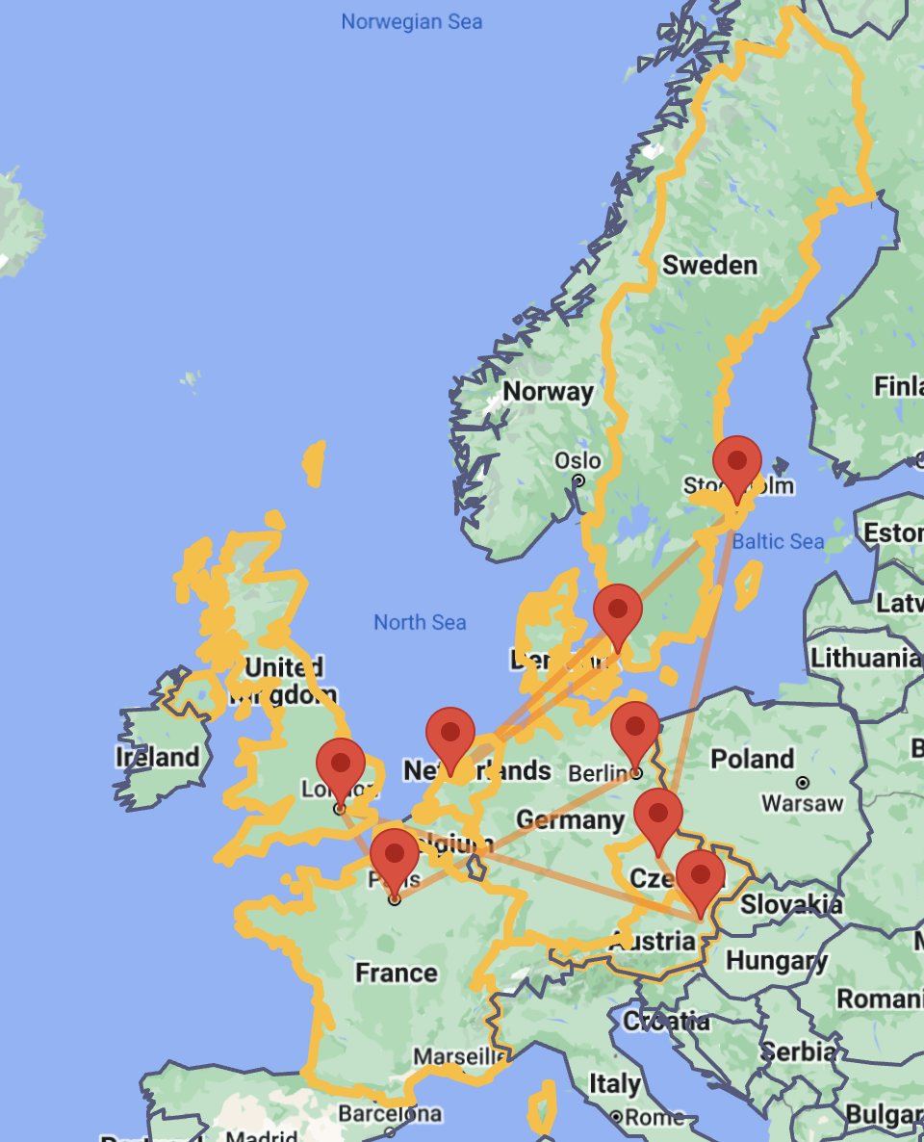
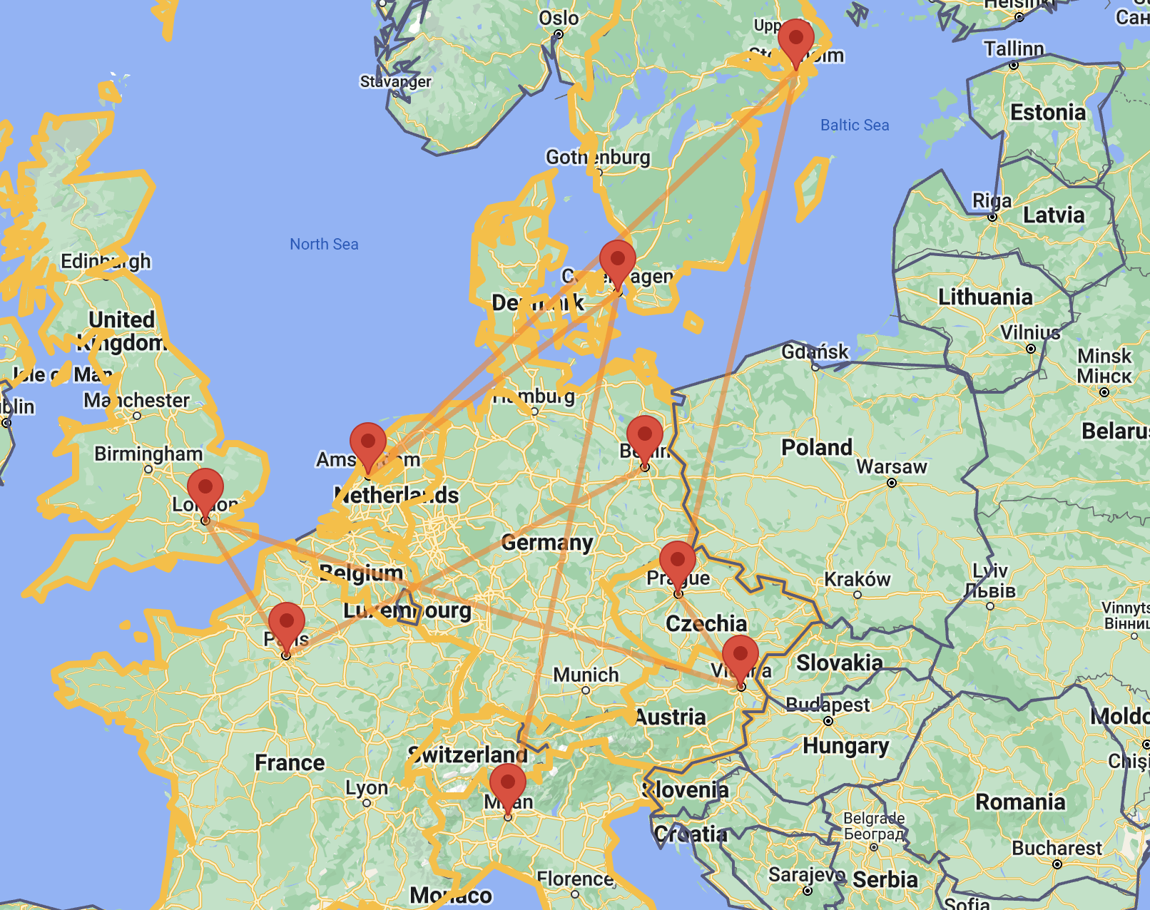
EXERCISE 2
22
Interrail: general context
Cities must be interconnected through railways in order to create an itinerary.

Slide 38
EXERCISE 2
23
Interrail: general context
We assume that the Person can move only to the cities that he has not visited yet.

Slide 39

EXERCISE 2
24
Interrail: general context
We want to keep track of whether the person is traveling or has arrived at the final destination.
Final destination=Milan

Slide 40
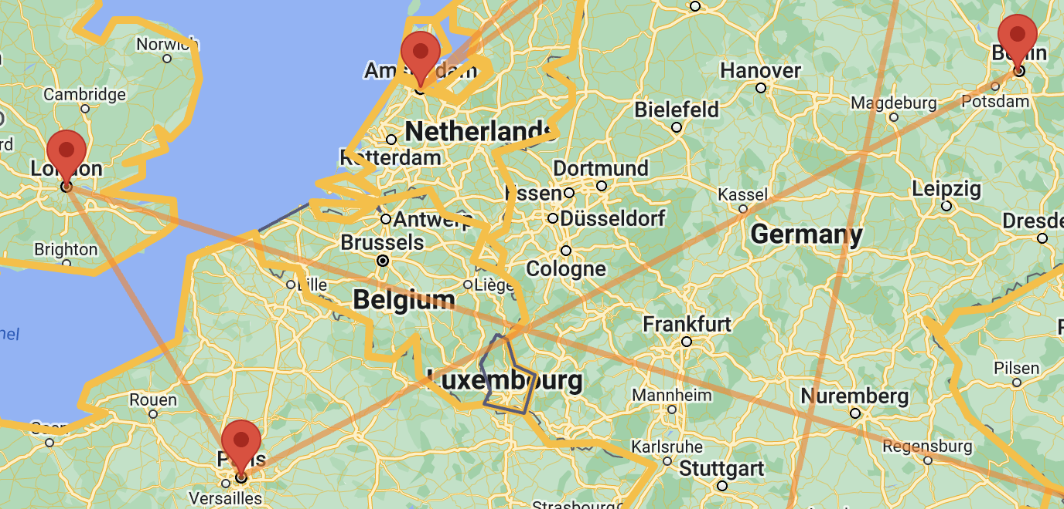
EXERCISE 2
25
Interrail: signatures
sig City {
linkedWith: some City,
name: disj one EuropeanCities
}
enum EuropeanCities {
Milan, Berlin, Paris, London, Vienna, Prague, Stockholm, Amsterdam, Copenaghen
}

Slide 41



EXERCISE 2
26
Interrail: signatures
sig Person {
pass: some City,
var loc: City,
var visited_cities: set City,
var status: Status
}
enum Status {
Travelling, AtDestination
}
t0
t1
t2
t3

Slide 42
EXERCISE 2
27
Interrail: contraints
//Cities have connections with each other
fact BidirectionalConnection {
all c1, c2: City | c1 in c2.linkedWith iff c2 in c1.linkedWith and !(c1 = c2) and c1.*linkedWith = City
}
//At the start of the interrail the person has not yet visited any cities
fact NoVisitedCitiesAtTheBeginning {
all p:Person | no p.visited_cities
}

Slide 43

EXERCISE 3
42
Message Deletion from Mailbox
Model a scenario in which messages can be deleted from a mailbox and later restored.
Hint: the Message ends up in a Trash and can be restored from there.

Slide 44
EXERCISE 3
43
Message Deletion from Mailbox
var sig Message {}
var sig Trash in Message {}
pred delete[m: Message] {
m not in Trash
Trash' = Trash + m
Message' = Message
}
pred restore[m: Message] {
m in Trash
Trash' = Trash - m
Message' = Message
}
pred empty {​
#Trash > 0
after #Trash = 0​
}​
​
pred doNothing {​
Message' = Message​
Trash' = Trash​
}​
​
pred restoreEnabled[m:Message] {​
m in Trash​
}​
Notes:
The goal of the Trash is to enable deleted files to still be restored until an (undoable) action of emptying the Trash is made: when a file is deleted it is stored in the Trash; while still in the Trash, a file can be be restored; after emptying, all files contained in the Trash are permanently deleted.

Slide 45
EXERCISE 3
44
Message Deletion from Mailbox
fact Behaviour {
no Trash
always {
(some m: Message | delete[m] or restore[m]) or empty or doNothing
}
}
run {}

Slide 46
EXERCISE 3
45
Message Deletion from Mailbox
assert restoreAfterDelete {
always (all m : Message | restore[m] implies once delete[m])
}
check restoreAfterDelete for 10 steps
check restoreAfterDelete for 1.. steps
assert deleteAll {
always ((Message in Trash and empty) implies after always no Message)
}
check deleteAll

Slide 47
EXERCISE 3
46
Message Deletion from Mailbox
check MessagesNeverIncreases {
always (Message' in Message and #Message' = #Message)
}
check IfNotDeletedMessagesNotEmpty {
(always all m : Message | not delete[m]) implies always not empty
}
// a deleted message can still be restored if the trash is not empty
assert restoreIsPossibleBeforeEmpty {
always (all m:Message | delete[m] implies after ((empty or restore[m]) releases restoreEnabled[m]))
}
check restoreIsPossibleBeforeEmpty for 3 but 1.. steps

Slide 48
ALLOY 6 CHALLENGE
Authors:
Luca Padalino
Francesca Pia Panaccione
Francesco Santambrogio

Slide 49
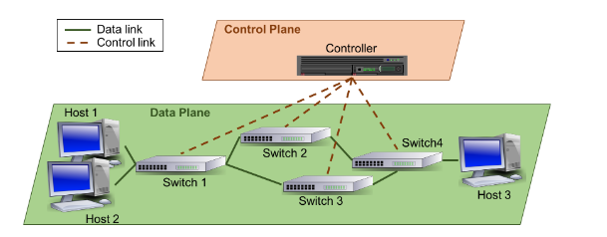
Software Defined Network
1
Definition
Software-Defined Network (SDN): A is a modern networking paradigm that explicitly separates the data and control planes to include intelligence in the network.

Slide 50
Software Defined Network
2
Controller and Switches
It is composed by these elements:
Controller: core entity of the SDN control plane. The network intelligence is logically centralized in the controller, which is able to dynamically configure the forwarding devices of the data plane in order to achieve a specific goal;
Switches: data plane components in charge of forwarding the data packets from its source to the destination. In SDNs, each switch has a routing table that contains a set of rules defining how the different incoming packets must be processed (forwarded, discarded, etc.). Each switch has also always a specific link (and thus a port) that connects it with the controller. This connection is mainly used to configure the switches. The data transmitted between nodes are called packets.

Slide 51
Software Defined Network
3
Packets
Packets that can be of two types:
control packets include control plane information, such as new rules that must be installed in an specific switch, or a request to know how to process a data packet;
data packets encapsulate information that must be transmitted from one host to another. In this case, the relevant information are the source and destination hosts, the type of data packets, and the current position in the network.

Slide 52
Software Defined Network
4
Switch
Switches contain tables with rules that specify how to route data packets. Simplifying, a rule is a structure with a field denoting the type of data packet (e.g. HTTP or FTP) and the input and output ports. The meaning of the rule is as follows:
If a data packet of a particular type arrives at port PortI, it must be forwarded through port PortO;
It is also possible to define rules that discard incoming data packets;
When a switch has no rule to deal with a data packet, it sends a request to the controller in order to know how to process the packet;
Finally, the controller can also send new rules to switches to update the routing tables.
packetType | action | iPort | oPort
... | ... | ... | ...
... | ... | ... | ...

Slide 53
Software Defined Network
5
Hosts
Hosts are the endpoints of the network, they are the source and destination of the data plane traffic. Although hosts are not specific elements of the SDN architecture, in our case study they are part of the model.

